Slide 1
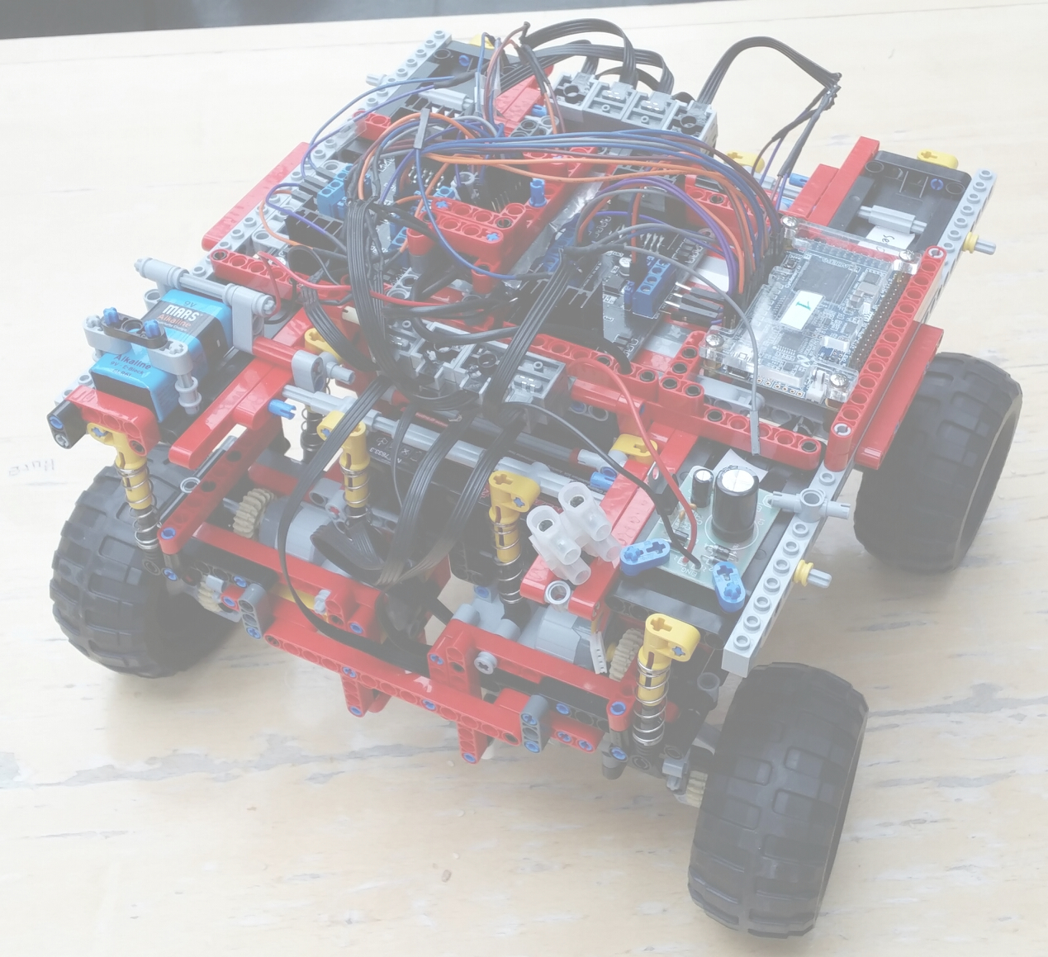
HW/SW Co-Design with a LEGO car
Final presentation
Group – LEGO 4 wheel 8 motors
Raphael, Antonio, Markus, Alibi, Adhir

Slide 2
Project overview
Hardware:
- 1 LEGO Car: 4 wheels, 8 motors (→ 2 motors per wheel)
- 1 FPGA
- 2 h-bridges
- WiFly-module for network connection
- 1 Battery (11,1 V)
- Tablet: Google Nexus 10 with Android 4.2.2
Goals:
Remote controllable car with Android App over WiFi
Speed and steering control: App ↔ WiFly-module ↔ FPGA
Receive and display speed information on the tablet
Modes for driving circles, parallel etc.

Slide 3
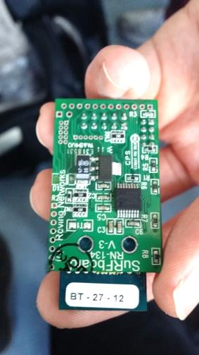
Wifly module
Initial Plan:
WiFi Chip
Communication between Android app and car
Plan: configure it as an access point
Android app is a client
Once connection is established both sides send and receive data
Problems:
First module was broken
is ping-able but not configurable
works on default settings
- telnet 1.2.3.4 results in timeout

Slide 4
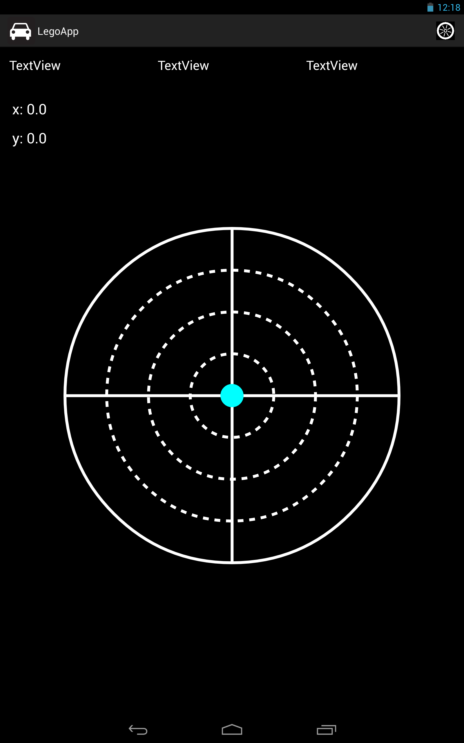
Android App
Challenges:
- Steep learning curve
- Problems with connection manager
- Support issues with the tablet
Accomplishments:
- Complete GUI
- Supports communication
over a network
- Completed raw structure
but abandoned in the end

Slide 5
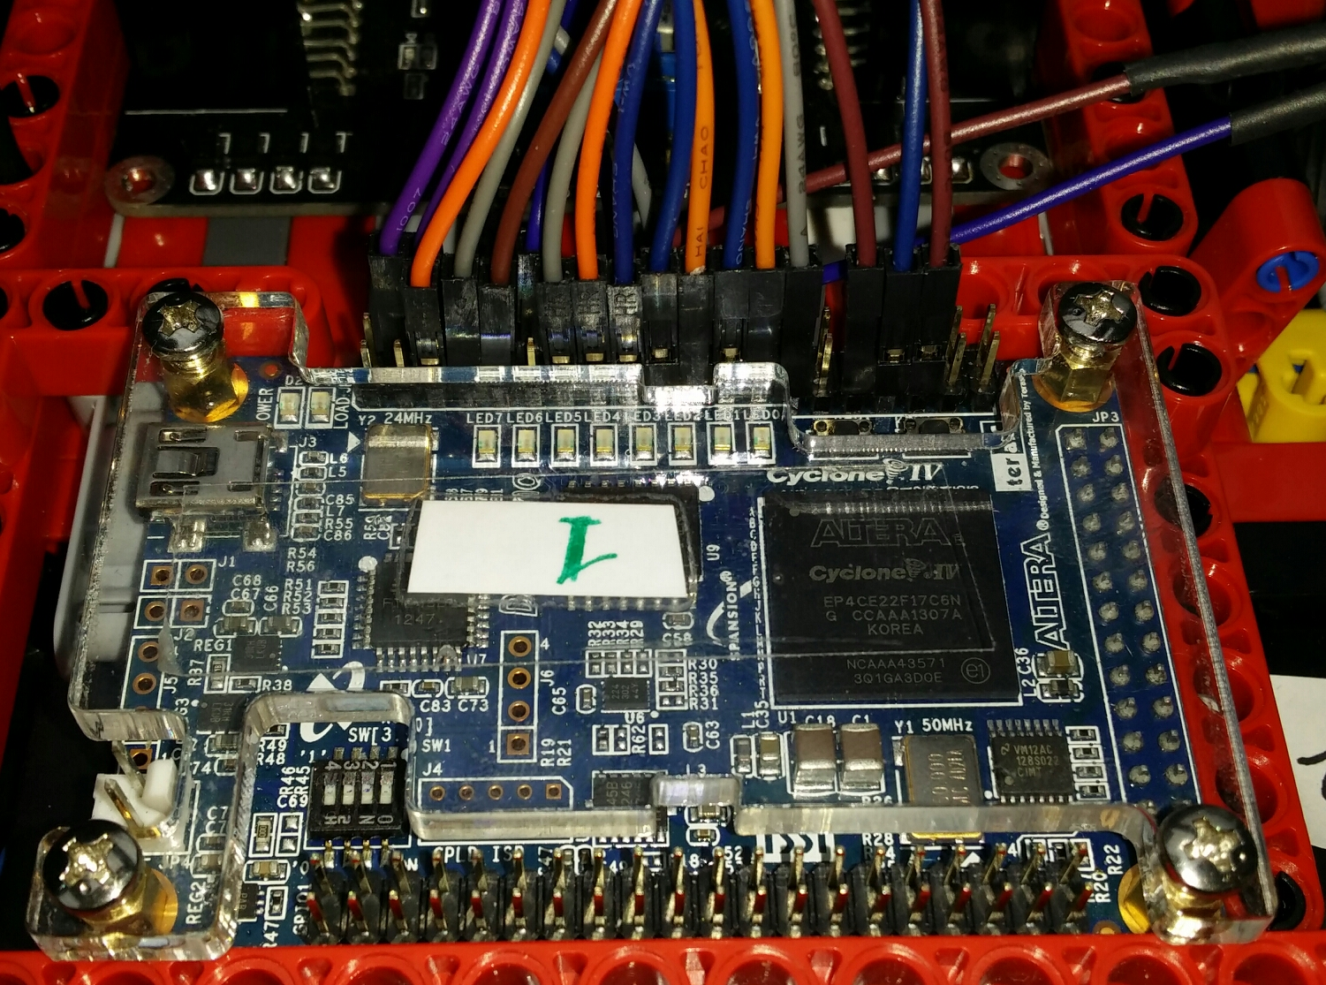
FPGA programming
Accomplishments:
- controlling all engines with PWMs
- different ways of moving the car:
driving curves
turning on the position
driving diagonal
- wheel stabilization (→ next slide)
- multithreading using MicroC-OS
Problems
- data cannot be sent to / received from the tablet

Slide 6
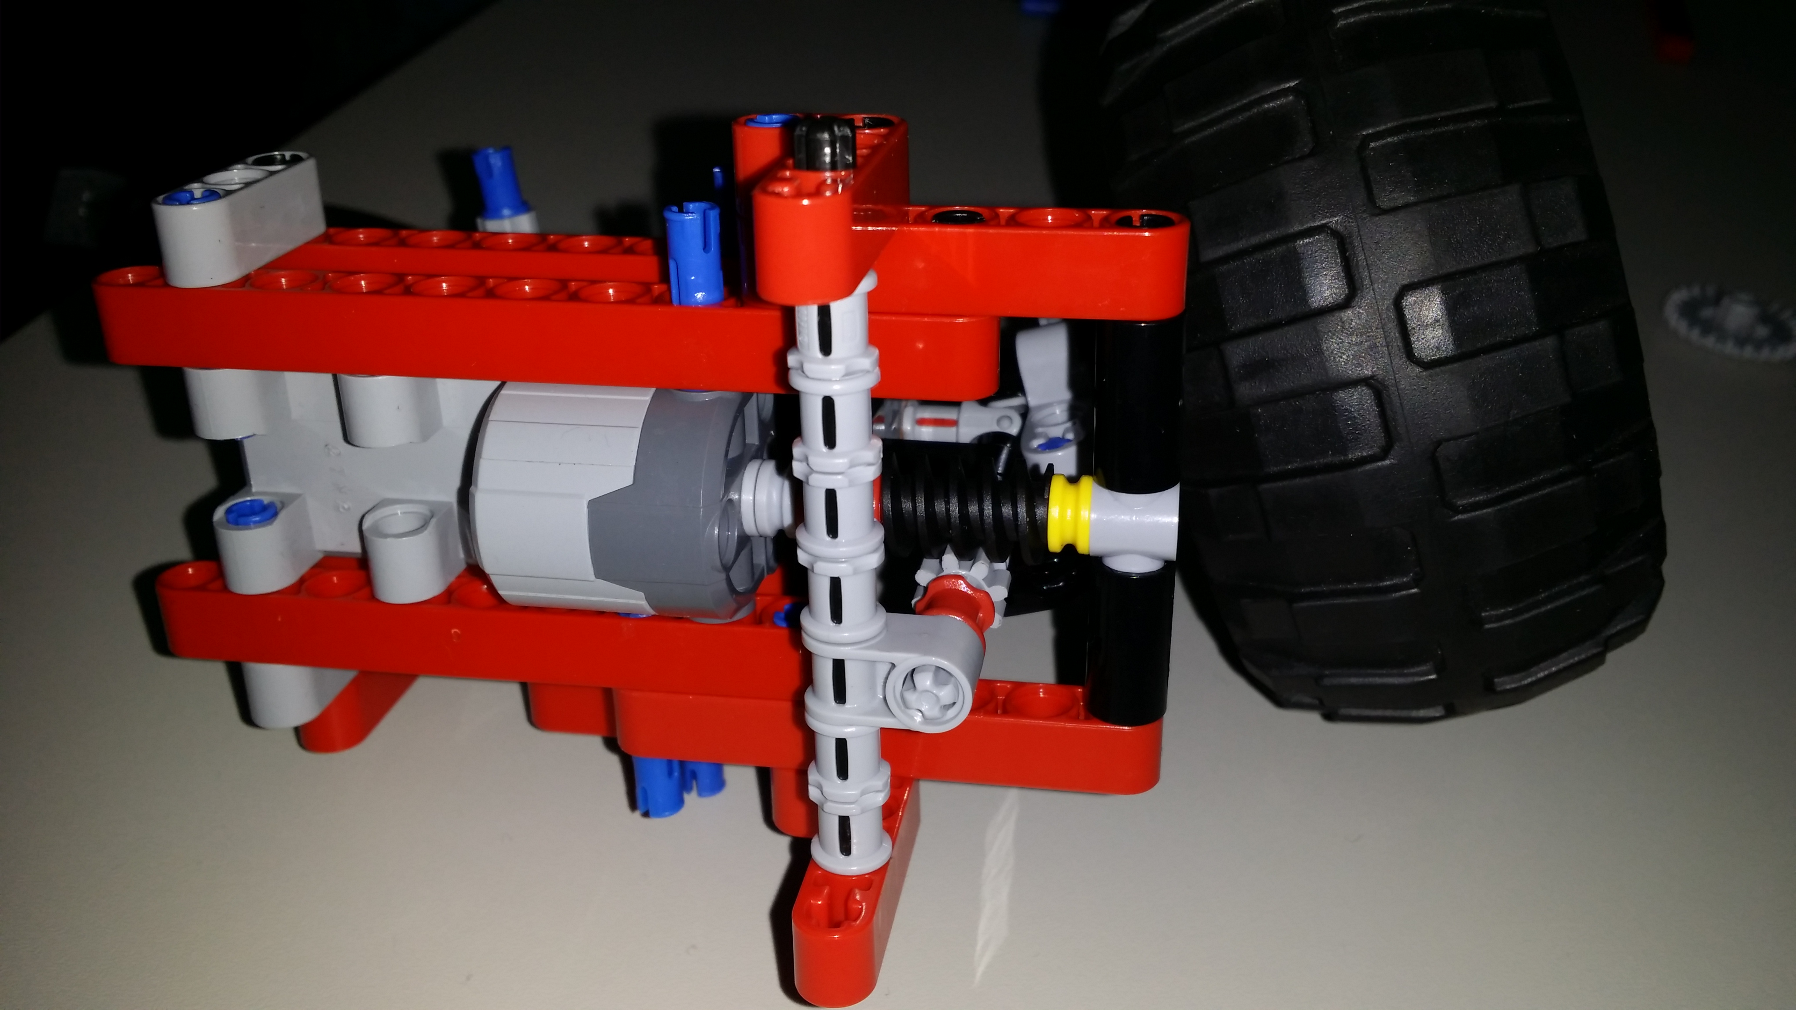
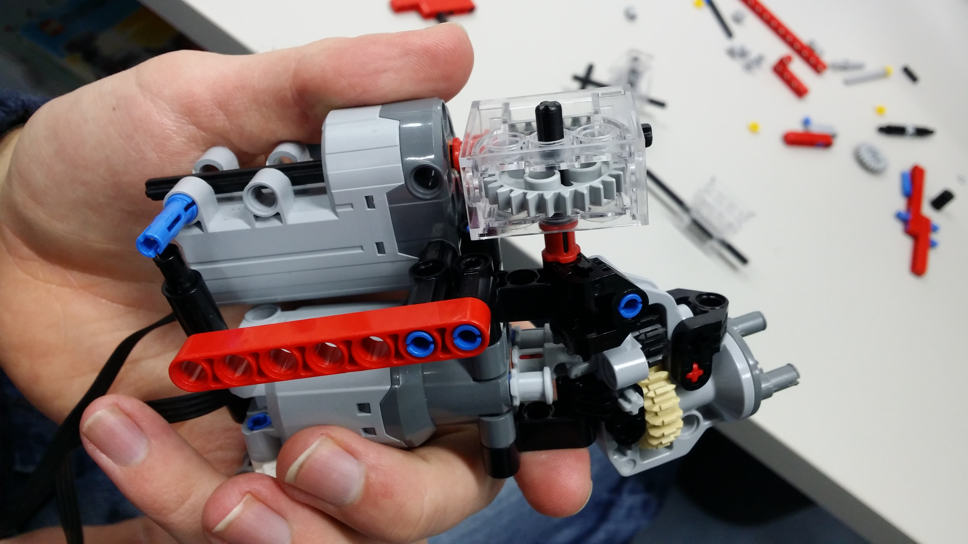
hardware design
wheels unstable due to design:
  wheels are not connected
  backlash in the direction control
  step-engines have small resistance (in stable state)
tested different designs:
  worm drive + small gear: still too unstable
  worm drive + large gear: stable but too slow

Slide 8
Summary
WiFi-Module | FPGA | Android
Setup Access Point | Straight movement Controlling the angles of the wheel | User interface
Process data received from network and send feedback | Reading data from acceleration sensor | Setup WIFI
Control engines remotely | Calculating speed and distance with acceleration sensor | Send control signals
 | Control Engine speed with A.S. | Receive feedback

Slide 9
Summary
WiFi-Module | FPGA | Android
Setup Access Point | Straight movement Controlling the angles of the wheel | User interface
Process data received from network and send feedback | Reading data from acceleration sensor | Setup WIFI on Tablet
Control engines remotely | Calculating speed and distance with acceleration sensor | Send control signals
 | Control Engine speed with A.S. | Receive feedback

